Slide 1
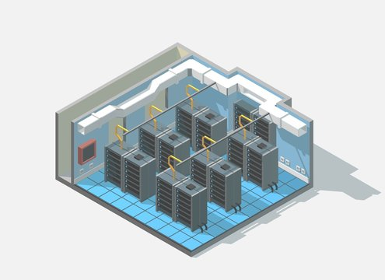

Slide 2
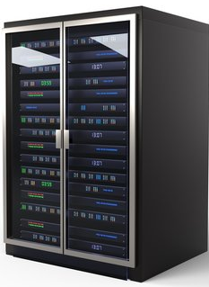
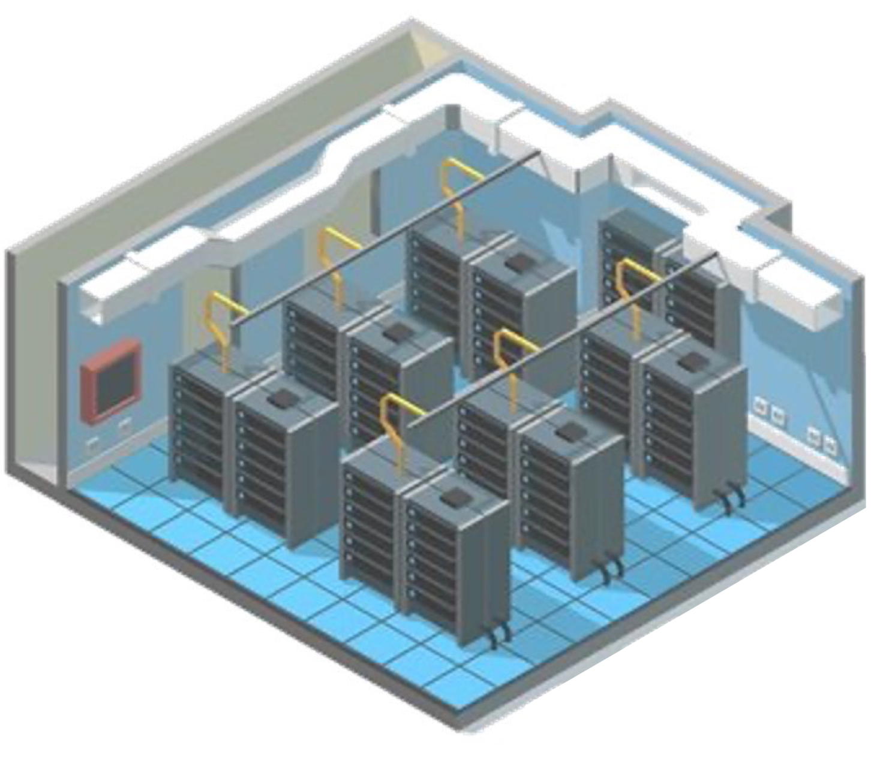
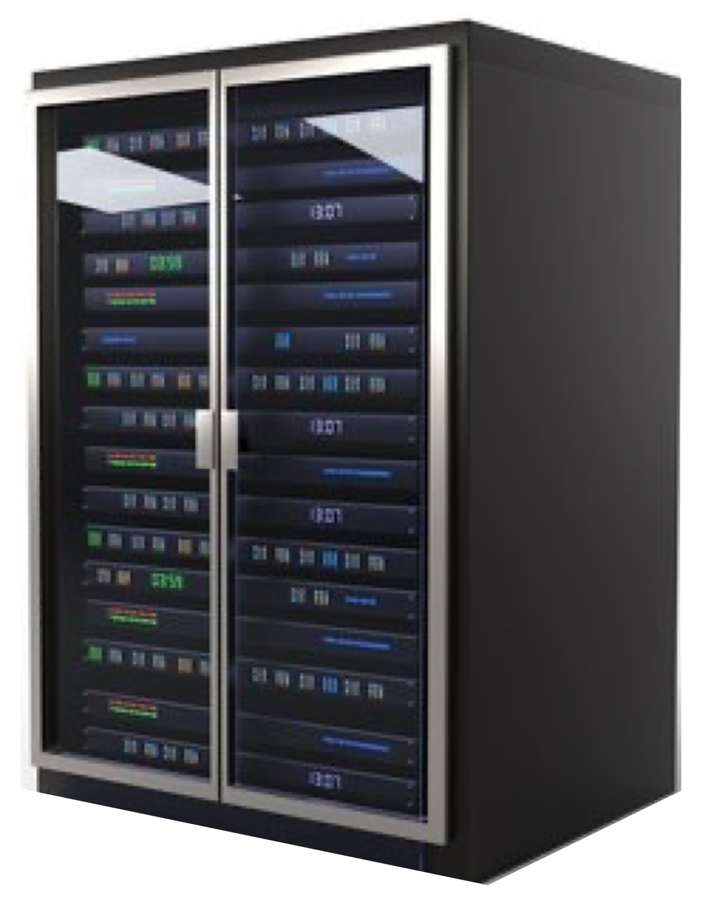

Slide 3







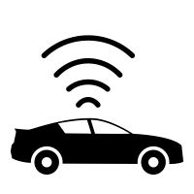

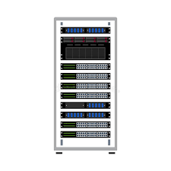



Local “Networked” Services
Linux / Containers / Container Managers
Virtual Machines
Edge / IoT Devices
Mobile Compute
Local Compute
Last Mile Networks
Cloud Edge Locations
Cloud Regional Datacenters

Slide 4
